Slide 1







DIABETES PREDICTION ASSESSMENT
DEVELOPED BY- KHUSHBOO PAL

Slide 2
INTRODUCTION
Welcome to our comprehensive SQL project report on Diabetes Prediction. This endeavor combines the realms of data analysis and healthcare to address the critical task of predicting diabetes. The project unfolds in the dynamic landscape of a real-world dataset, encompassing essential variables such as gender, age, hypertension, heart disease, smoking history, BMI, HbA1c levels, blood glucose levels, and the presence or absence of diabetes.
This dataset mirrors the intricate nature of healthcare data, presenting an exceptional opportunity to refine and showcase SQL skills. Throughout this report, we delve into the diverse dimensions of the data, utilizing SQL to extract valuable insights and contribute to the realm of predictive healthcare analytics.

Slide 3
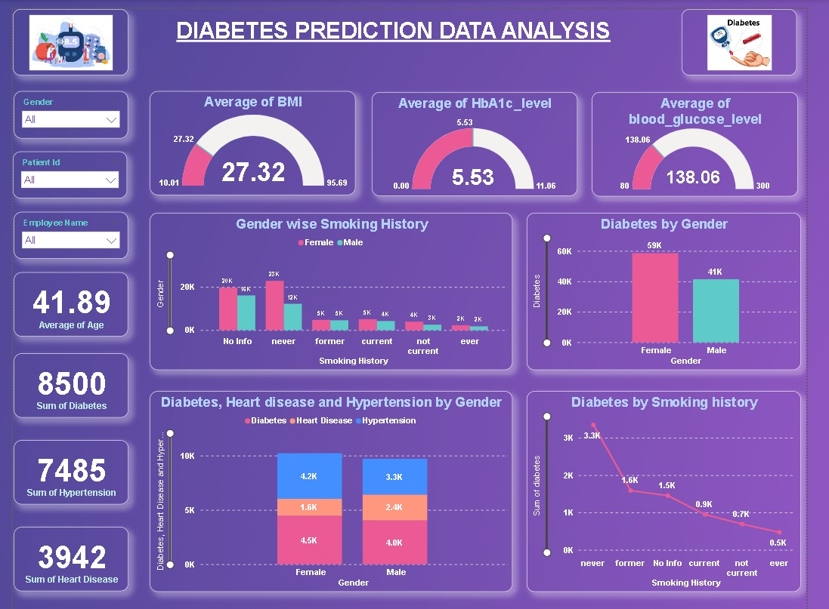
DIABETES PREDICTION DASHBOARD USING POWER BI

Slide 4
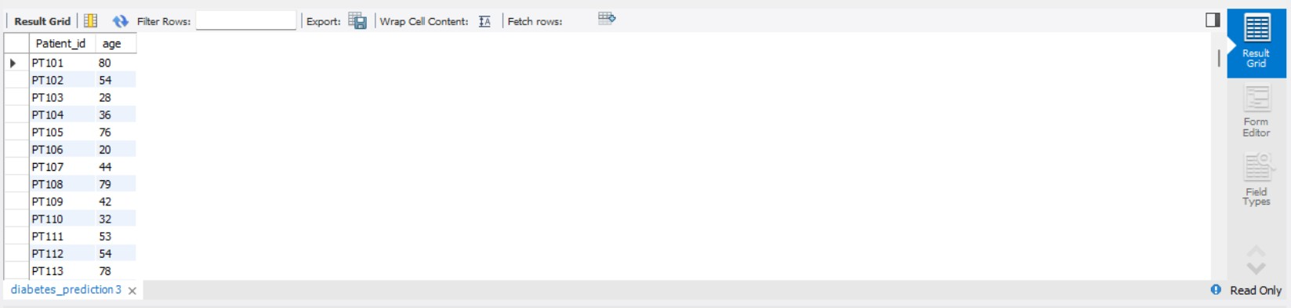
1. Retrieve the Patient_id and ages of all patients.
QUERY
OUTPUT

Slide 5
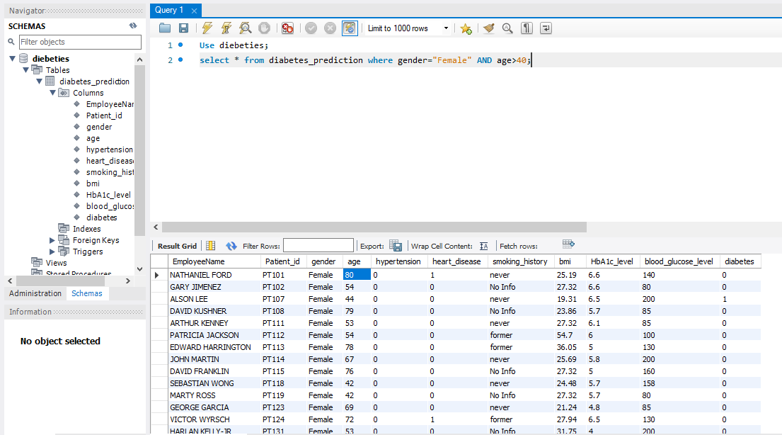
2. Select all female patients who are older than 40.
QUERY
OUTPUT

Slide 6
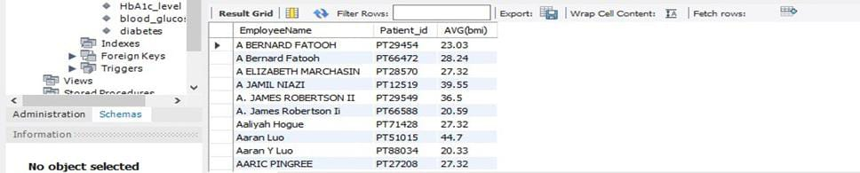
3. Calculate the average BMI of patients.
QUERY
OUTPUT

Slide 7
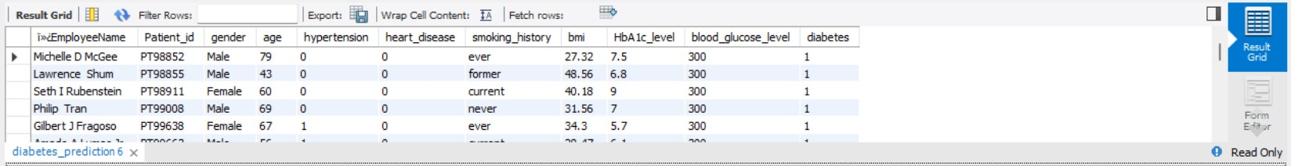
4. List patients in descending order of blood glucose levels.
QUERY
OUTPUT

Slide 8
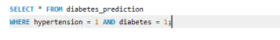
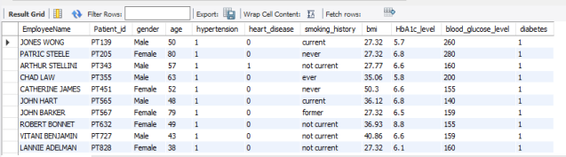
5. Find patients who have hypertension and diabetes.
QUERY
OUTPUT

Slide 9
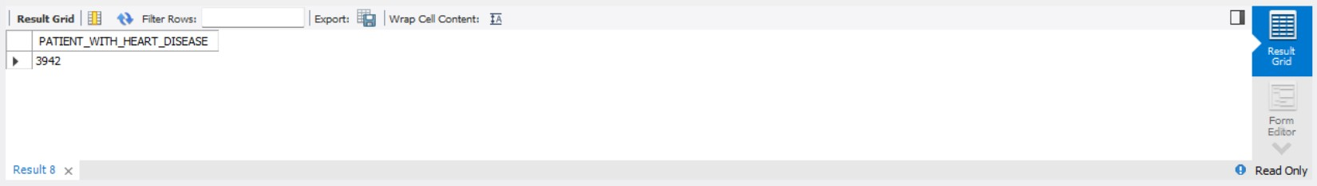
6. Determine the number of patients with heart disease.
QUERY
OUTPUT

Slide 10
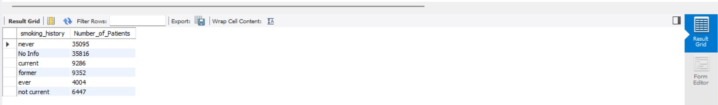
7. Group patients by smoking history and count how many smokers and non-smokers there are.
QUERY
OUTPUT

Slide 11
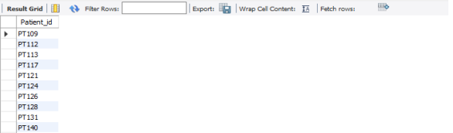
8. Retrieve the Patient IDs of patients who have a BMI greater than the average BMI.
QUERY
OUTPUT

Slide 12
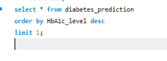
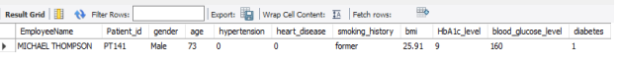
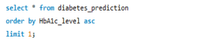
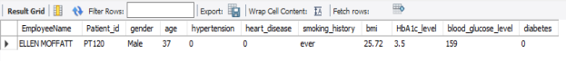
9. Find the patient with the highest HbA1c level and the patient with the lowest HbA1clevel.
Highest HbA1c_level Query
Highest HbA1c_level OUTPUT
Lowest HbA1c_level Query
Lowest HbA1c_level OUTPUT

Slide 13
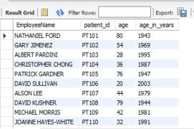
10. Calculate the age of patients in years (assuming the current date as of now)
QUERY
OUTPUT

Slide 14
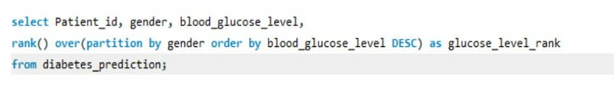
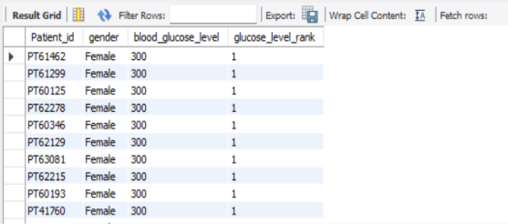
11. Rank patients by blood glucose level within each gender group.
QUERY
OUTPUT

Slide 15
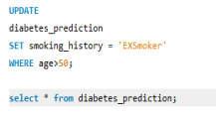
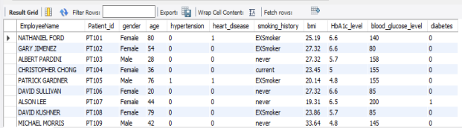
12. Update the smoking history of patients who are older than 50 to "Ex-smoker."
QUERY
OUTPUT

Slide 16
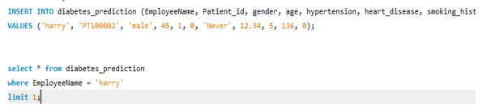
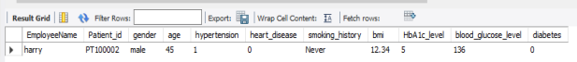
13. Insert a new patient into the database with sample data.
QUERY
OUTPUT

Slide 17
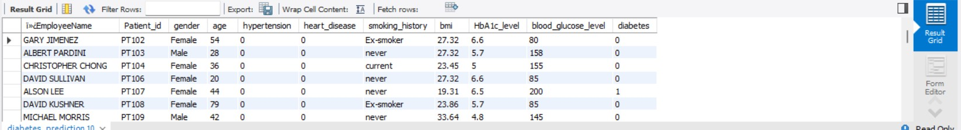
14. Delete all patients with heart disease from the database.
QUERY
OUTPUT

Slide 18
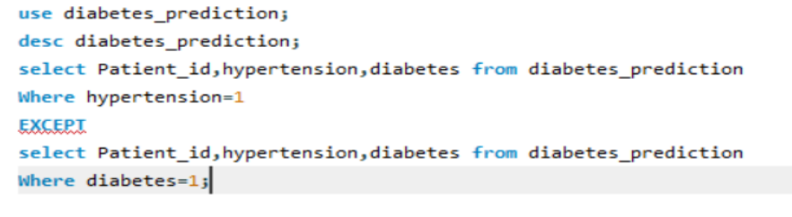
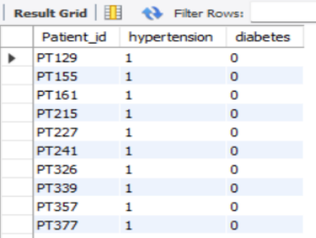
15. Find patients who have hypertension but not diabetes using the EXCEPT operator.
QUERY
OUTPUT

Slide 19

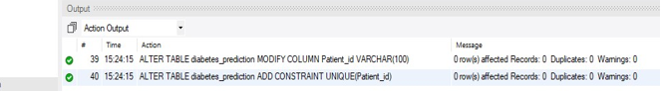
16. Define a unique constraint on the "patient_id" column to ensure its values are unique.
QUERY
OUTPUT

Slide 20
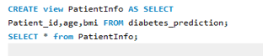
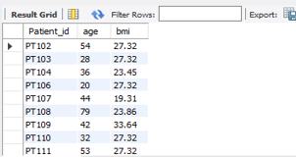
17. Create a view that displays the Patient_ids, ages, and BMI of patients.
QUERY
OUTPUT

Slide 21
18. Suggest improvements in the database schema to reduce data redundancy and improve data integrity.
Index frequently queried columns for improved performance.
Set appropriate default values.
Enforce data integrity with constraints like NOT NULL.
Utilize foreign keys or separate tables for shared information.
Document relationships and constraints for easy reference.

Slide 22
Explain how you can optimize the performance of SQL queries on this dataset.
Replace subqueries with JOINs or EXISTS for improved performance.
Create indexes on frequently used columns to speed up query execution.
Utilize covering indexes to include all columns needed for a query, eliminating the need for additional lookups.
Avoid using SELECT *; only select necessary columns to minimize data transfer.
Encapsulate complex queries in stored procedures for reduced network traffic and better query plan caching.

Slide 23

Thank You

